Slide 1



The Beauty and Joy of Computing Lecture #18
Besides Blocks I:
Intro to Python
Jonathan
McKinsey

Slide 2
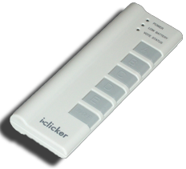
How do you feel about learning Python?
Very Excited. I am ready for something new.
Sort of Excited.
I don’t feel strongly either way.
Sort of dreading it.
Dread. I just got used to Snap!
Notes:
Taipei, Taiwan
Florence, Italy
Tel Aviv, Israel
Helsinki, Finland
Hong Kong, China
Macau, China
Paris, France
New York, USA
Perth, Australia

Slide 3
Why Learn Python?

Slide 4
The Goals of Beauty and Joy of Computing (BJC)
BJC’s goal is not to teach you about a specific programming language, but to teach you about:
critical thinking about social implications of computing
how to program and help you succeed in the future
how to think like a computer scientist also known as computational thinking

Slide 5
What is Computational Thinking?
Using abstraction
removing detail
generalization
Understanding the value of a “specification” that defines a contract
The iterative design cycle: design, proof-of-concept, prototype, test, repeat
Thinking about how solutions scale and trying to foresee the unintended consequences!

Slide 6
Why Learn Python?
Python runs everywhere
Operating Systems (OS X, Windows, Linux, iOS, Android)
Websites
Large user community and online support
Plenty of advanced libraries
Everything from graphics processing to AI to games!
Used in industry and academia

Slide 7
What You’ll Learn
New syntax
Different way to express algorithms
A little bit about the command line
A text-based interface that exposes you to the internals of how a computer works
(next time) A little more about Object Oriented Programming

Slide 8
Intro to Python

Slide 9

Getting Python 3
We’ll be using Python 3 for this class.
Python 3 is not backwards-compatible with Python 2.
For this class, you don’t need to worry about the differences between Python 2 and 3.
Download Python 3 from
https://python.org/downloads
Run the graphical installer
All official Python documentation is at
https://docs.python.org

Slide 10
Intro to the Command Line
http://www.wired.com/2012/07/command-line/
Naming
Terminal on OS X and Linux
Command Prompt on Windows
History
Proceeded the graphical user interface (GUI)
How to Open:
OS X - Open: /Applications/Utilities/Terminal.app
Windows - Use the search bar to look for “Command Prompt”
OS X/Linux | Windows
Terminal | Command Line

Slide 11
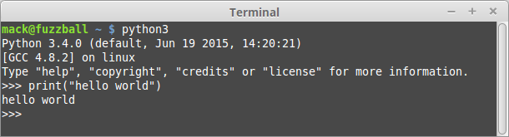
Python Programs
Python programs are just a text file with Python syntax.
To run a program you type:
python3 file_name.py
(See table for variations)
Python has two modes – normal and interactive
Interactive mode happens if you don’t provide a file to run.
After each command Python evaluates your code and returns the response.
Kind of like clicking a block in Snap!
 | OS X/Linux | Windows
Python 2 | python | py -2
Python 3 | python3 | py -3

Slide 12
Snap! to Python

Slide 13


Text and Numbers
Numbers in Python are called
ints (numbers w/o decimals)
floats (numbers with decimals)
Strings:
Some text in between quotes “” or ‘’

Slide 14
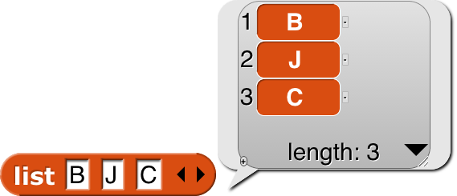


Lists
Lists Work in much the same way:
Syntax: [item1, item2, item3]

Slide 15
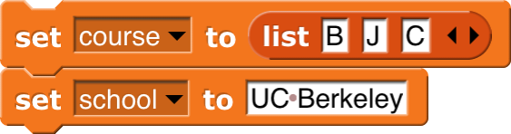

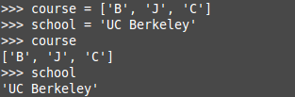
Variables
No need to “declare” variable in Python,
Just use = for assignment
To access a variable, type its name

Slide 16



Zero-based Versus One-based Indexing
Python is zero-based
when indexing, the first index is 0.
Snap! Is one-based.
when indexing, the first index is 1.
Access items using [#]

Slide 17
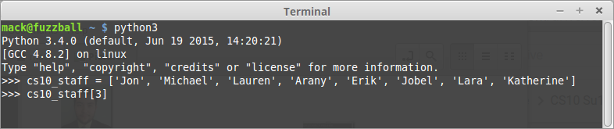
What is the output?
Michael
Lauren
Arany
Erik
Jobel

Slide 18
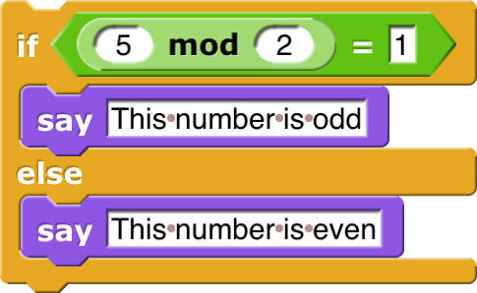
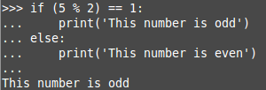
Conditionals
Syntax:
End the condition with :
Parentheses are optional around the condition.
Indent the body one “level” (usually 4 spaces)
Indentation matters in Python!
To end a condition, just un-indent your code
mod in Python is a %
equivalence check is ==
Python also supports an if (without the else) just like Snap!

Slide 19
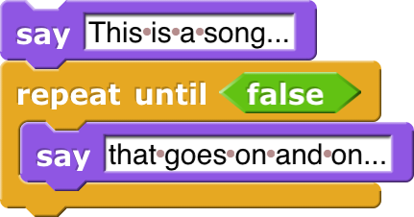
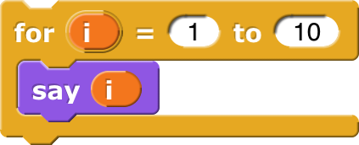
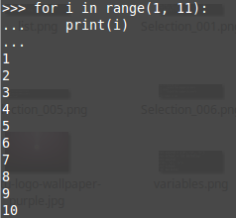
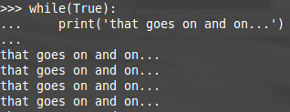
Loops
Instead of a repeat until loop, Python has a while loop.
Python is missing the repeat loop and the forever loop, but you can make these with while and for loops.
Note: range() is a built-in function which is includes the first item, but not the last!
range(1,11) counts from 1 to 10!

Slide 20
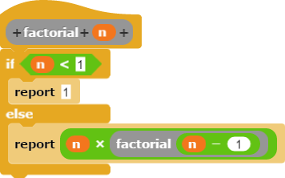
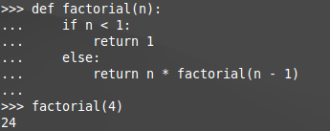
Functions
There is no distinction between a command, reporter or predicate.
You can simply use: return None or just return
Python uses the word def
The body of function is indented
All arguments are specified in () and must come at the end of the function name
report = return
Recursion works exactly the same as in Snap!
Call a function like this: name(arg1, arg2..)

Slide 21
Summary
Lots of little syntax differences!
The Python documentation is your friend
Don’t get too hung up on the differences and don’t get discouraged when you get an error!
There’s so much more to Python in the coming weeks:
Python has thousands of additional, useful built in tools
Python supports HOFs and lambdas
Lots of cool libraries to explore (including turtle graphics)

Slide 22
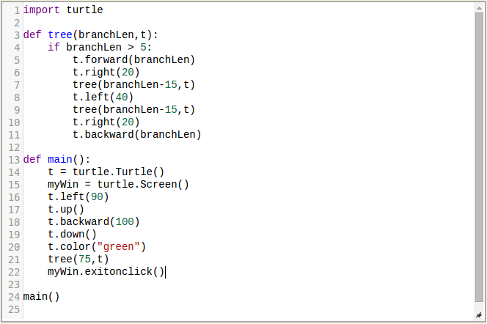
Preview
http://interactivepython.org/runestone/static/pythonds/Recursion/graphical.html

